Slide 1
PTFW Parents, Teachers & Faith Warriors November 18, 2020

Slide 2
Scrips
What is it and how does it help our school?
https://shop.shopwithscrip.com/Login/Enroll
Enrollment Code: 69E6656F73L23
An email with directions was sent to all parents
Anyone can join, so please share with your family and friends
Please use Scrips for your holiday gift card ordering!

Slide 3
Treasurer Update- Melissa Brockman
Teacher Appreciation Lunch
Lunch from Vino E Pasta
Gift Cards Purchased
Scrips “ThankScripping Day”

Slide 4
Treasurer Update- Melissa Brockman
PTFW Financials Update
Starting balance $5,351.61
Uniform sales +$125.00
Birthday Shout outs +$140.00
Scrips +$155.40
Dairy joy spirit night +$171.12 (not credited yet)
Fall Apprec. gift card -$1000.00
Current Balance +$4,772.01

Slide 5
School Fundraisers Update- Gigi Cooper
Fun Run Update
Please see emails sent by Gigi or visit the school website for opportunities to help and more information

Slide 6
Upcoming School Events
Stay up to date by subscribing to the school calendar
https://www.bayshorechristianschool.org/calendar.cfm

Slide 7
Spirit Night Updates- Amanda Melton
Dairy Joy
Great turn out. Thank you!
Chipotle
December 9th 5:00-8:00
Dine in or take out, flyers and codes will be shared the week of November 30th
Anthony’s Coal Fire Pizza
February 17th
Time and details will be shared closer to the date
PDQ
April 21st
Time and details will be shared closer to the date

Slide 8
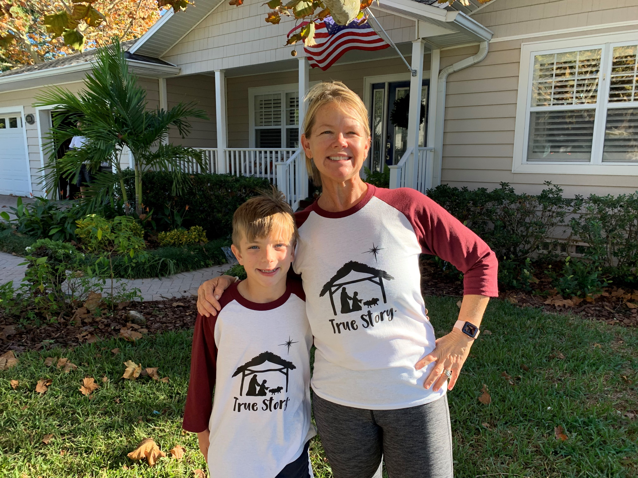
Joy Boutique
Will take place December 8th and 9th
Students shop for presents that mostly range in price from $2-$5.
“True Story” shirts are also available for $20 at the Boutique
Student can pay with cash (disinfecting will be a top priority throughout the shopping)

Slide 9
Joy Boutique
Donations needed:
Please drop off to the front office of the school
Items for students to purchase
Thank you to those who have already donated! We want to share your business website and contact information with our families, so please send that to Laurie Daigle at lkdaigle@verizon.net
Gift wrap
Gift bags
Tissue paper
Cardstock for signs
Scotch tape
Gift tags

Slide 10
Teacher Appreciation
Lunch on December 11th
We need help decorating the media center Thursday, December 10th after school
Please email PTFW@Bayshorechristianschool.org if you’d like to help
We will also restock the teacher’s lounge and assist with some re-organizing in there
Please email PTFW@Bayshorechristianschool.org if you’d like to help

Slide 11
Poinsettia Sale- Marolda Cameron
Funds raised go to athletics
Orders will be taken 11/2-11/30
Poinsettias will be delivered 12/8 and can be picked up between 2:30-3:30
Digital order forms will be available on the PTFW page of the school website: https://www.bayshorechristianschool.org/support-bcs/ptfw.cfm

Slide 12
Box Tops
How to submit?
Scan/Submit receipts
All you need is your phone- Download the Box Tops app, shop as you normally would, then simply scan your store receipts to find participating products. The app will automatically credit your school's Box Tops earnings online
You can also forward any email receipts from online grocery purchases to receipts@boxtops4education.com
You can still send them into school attn: Lisa Milne

Slide 13
Spirit Store Update
We ordered more shirts because they sold out!
Order will be in this week
Please email Laurie Daigle at lkdaigle@verizon.net to order
Refer to PDF sent earlier in the year for shirt numbers
The information is also on the PTFW page of the school website https://www.bayshorechristianschool.org/support-bcs/ptfw.cfm

Slide 14
Homeroom Parents
If you are a homeroom parent, please see the email sent by me with some helpful hints and reach out to your child’s teacher to see how you can best help him or her.

Slide 15
Service Hours
Coordinated through the school
You can view them online
Please see the email sent by the school
Coordinator is Ms. Denny- SDenny@bayshorechristianschool.org

Slide 16
Thank you! Questions

