Slide 1
PTFW Parents, Teachers & Faith Warriors February 3, 2021 *PLEASE BE SURE YOUR FIRST AND LAST NAME ARE LISTED AS THE ZOOM PARTICIPANT NAME FOR ATTENDANCE

Slide 2
School Fundraisers Update
Spring Gala April 16th
Tickets available on school website
Gala page under Support BCS
Want to help? Email Gigi at GCooper@bayshorechristianschool.org

Slide 3
Treasurer Update- Melissa Brockman
Financials Update
Income:
* Birthday shout outs $ 250
*Uniforms $ 110
*Dairy Joy spirit night $ 171.20
*Joy Boutique $1,175.95
*Chipotle spirit night $ 120.78
*Scrips $ 870.73
Expenses:
* Teacher Appreciation $1,618.70
$1,000 to gift cards
$ 618.70 Vino E Pasta
(Budget was $1,800)
Account Balance $6,841.97

Slide 4
Scrips
How to enroll:
https://shop.shopwithscrip.com/Login/Enroll
Enrollment Code: 69E6656F73L23
Successful so far! Thank you for your support.
Please remember to use throughout the year

Slide 5
Upcoming School Events
Stay up-to-date by subscribing to the school calendar
https://www.bayshorechristianschool.org/calendar.cfm
Wear Bucs shirts/jerseys or colors Friday (Land's End bottoms)!! GO BUCS!!!

Slide 6
Bayshore Christian Family Businesses Directory
We want to share the information of businesses owned or operated by Bayshore Christian School families in a directory on our PTFW website.
Please complete this form by February 10th to be included: https://forms.gle/Na81E1JUFKsGsXYj8 (form was also emailed February 2nd)

Slide 7
Spirit Night Updates- Amanda Melton
Dairy Joy and Chipotle
Great turn out. Thank you!
Anthony’s Coal Fire Pizza at 1901 S Dale Mabry, 33629
February 17th 11:00am-9:00pm! ALL DAY!!
Mention Bayshore Christian School at checkout in person or on the phone (813) 258-2625
Online or delivery apps: in section for order notes or special instructions add Bayshore Christian School
We get 20% of all orders!
PDQ
April 21st
Time and details will be shared closer to the date

Slide 8
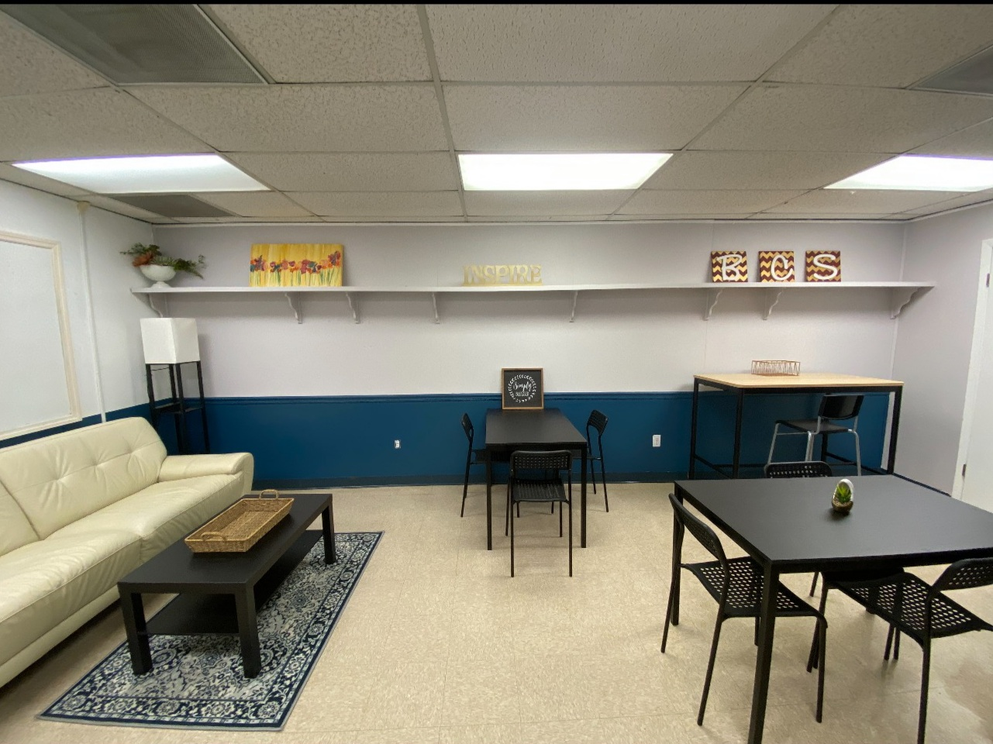
Teacher Appreciation
Thank you to Amanda Keovongsa and Heather Traynor for the beautiful update to the Teacher's Lounge!
Amanda also plans to head a new Teacher Appreciation Committee that will deliver monthly surprises to the teachers. More details to come!

Slide 9
Parent/Teacher Coffee Social
When: Thursday, 2/11
All are welcome from 7:30-9:00 am but please let teachers go first so they can get to class :)
PTFW and the school will provide coffee from Dunkin’ Donuts with lots of yummy creamers!
REMEMBER: Please practice social distancing and wear a mask when not drinking coffee
Email reminder will be sent next week
Help with coffee pick up? 7:15 am on 2/11

Slide 10
Teacher Wish List
Because of your amazing support this year, we are dedicating $2,000 to fulfilling teacher wish lists for their classrooms! THANK YOU!
Mrs. Kemp needs someone to mount a projector and screen in the media center. Can anyone help or know someone who can?

Slide 11
Box Tops
How to submit?
Scan/Submit receipts
All you need is your phone- Download the Box Tops app, shop as you normally would, then simply scan your store receipts to find participating products. The app will automatically credit your school's Box Tops earnings online
Use referral code UO28ZQS when you sign up for 25 bonus box tops when you scan your first receipt now through 2/17/21
You can also forward any email receipts from online grocery purchases to receipts@boxtops4education.com
You can still send them into school attn: Lisa Milne

Slide 12
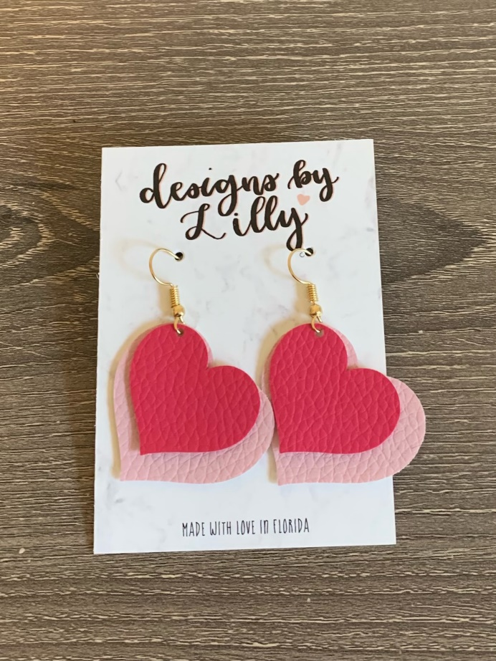
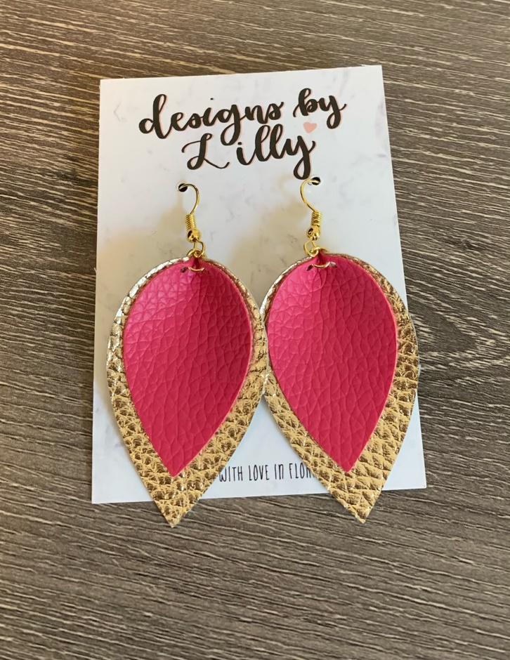
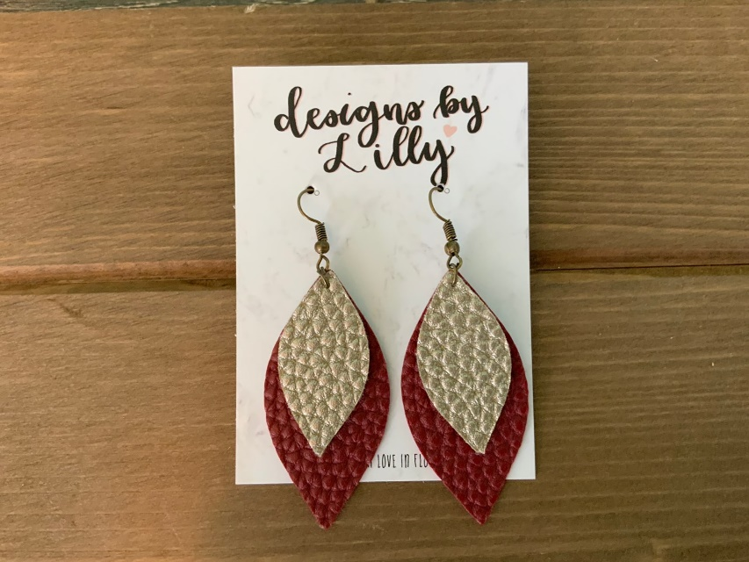
Spirit Store Update
Store open TOMORROW 7:45-8:15
Shirts are back in stock!
NEW ITEM: Leather earrings $10
Please email Laurie Daigle at lkdaigle@verizon.net to order if you cannot make it to the store
Refer to PDF sent earlier in the year for shirt numbers
The information is also on the PTFW page of the school website https://www.bayshorechristianschool.org/support-bcs/ptfw.cfm

Slide 13
Homeroom Parents-Maria Wilson
If you are a homeroom parent, please remember to check in with the teacher to see how you can help
Cleaning wipes and hand sanitizer are always appreciated!

Slide 14
Service Hours
Coordinated through the school
You can view them online
Please see the email sent by the school
Coordinator is Ms. Denny- SDenny@bayshorechristianschool.org

Slide 15
Thank you! Questions

